Slide 1
Code Explainer
Code Explainer is your personal AI assistant for coding. Seamlessly check syntax,get explanations, and enhance your coding experience with cutting-edge AI technology
Transforming user interactions:Our project seamlessly integrates AI-driven chat functionalities, offering personalized assistance and real-time syntax analysis for enhanced user experience.

Slide 2
Features
Authentication: The application provides password-based login to ensure secure access .
Language Selection:Users can choose from multiple Programming languages such as Java, python, and C for their code snippets.
Syntax Checking: Real-time analysis of code syntax is performed, providing immediate feedback to users on any errors.
Generative Chat: Users can interact with an AI model for explanations and assistance in a conversational manner .

Slide 3
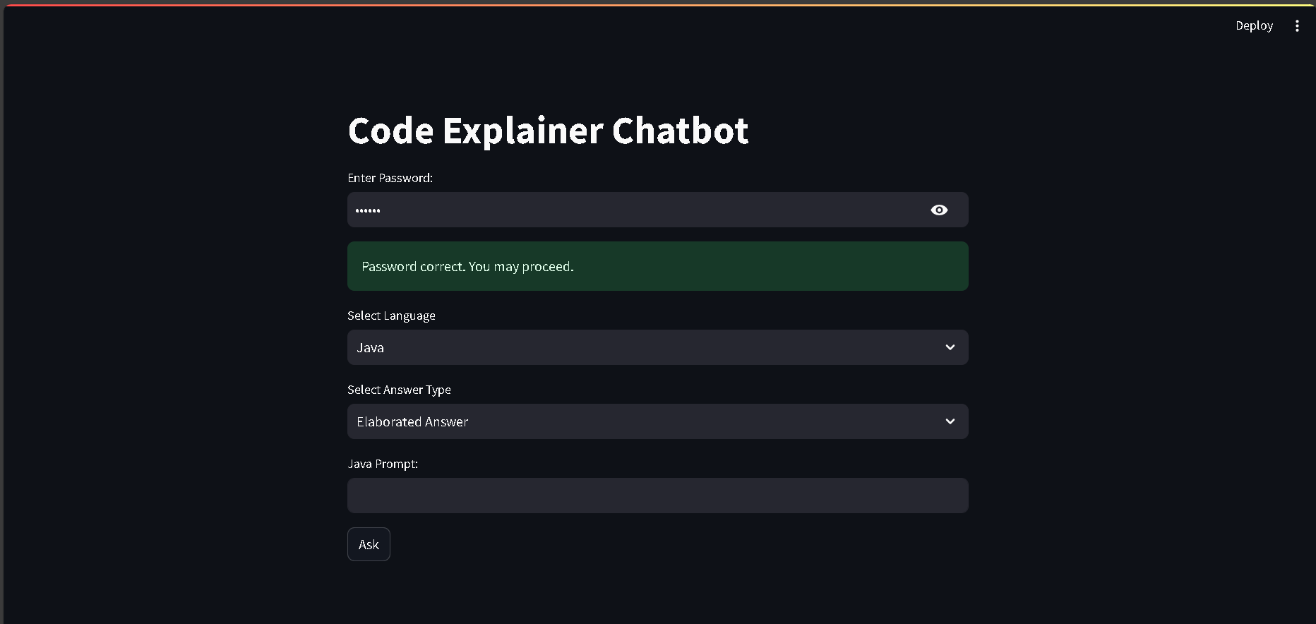
User Interface
Landing page using streamlit

Slide 4
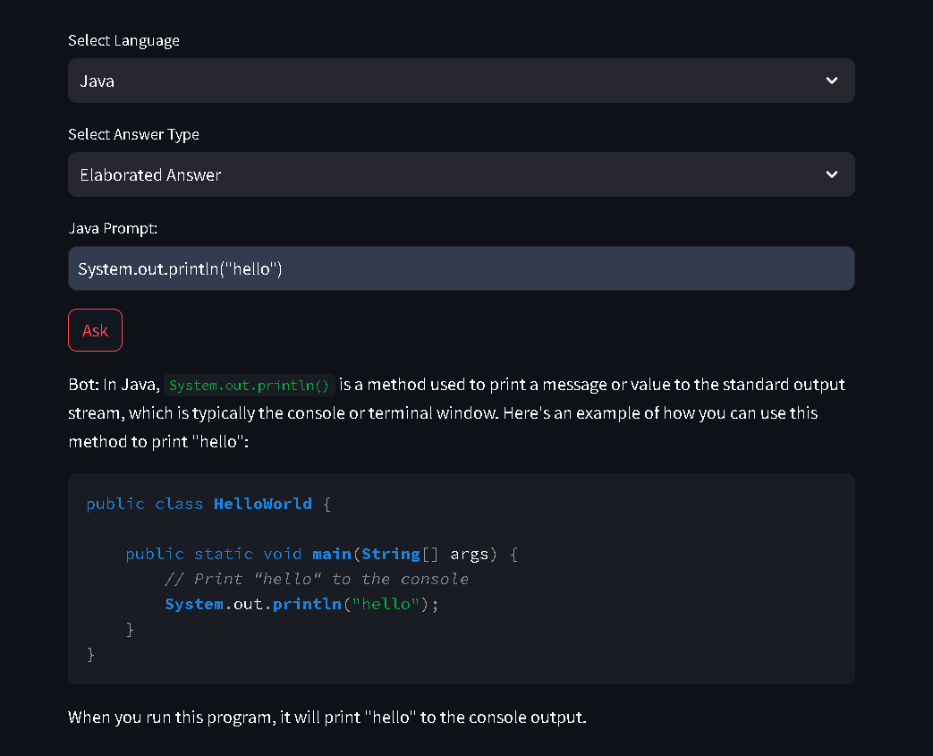
User Interface
Java Code

Slide 5
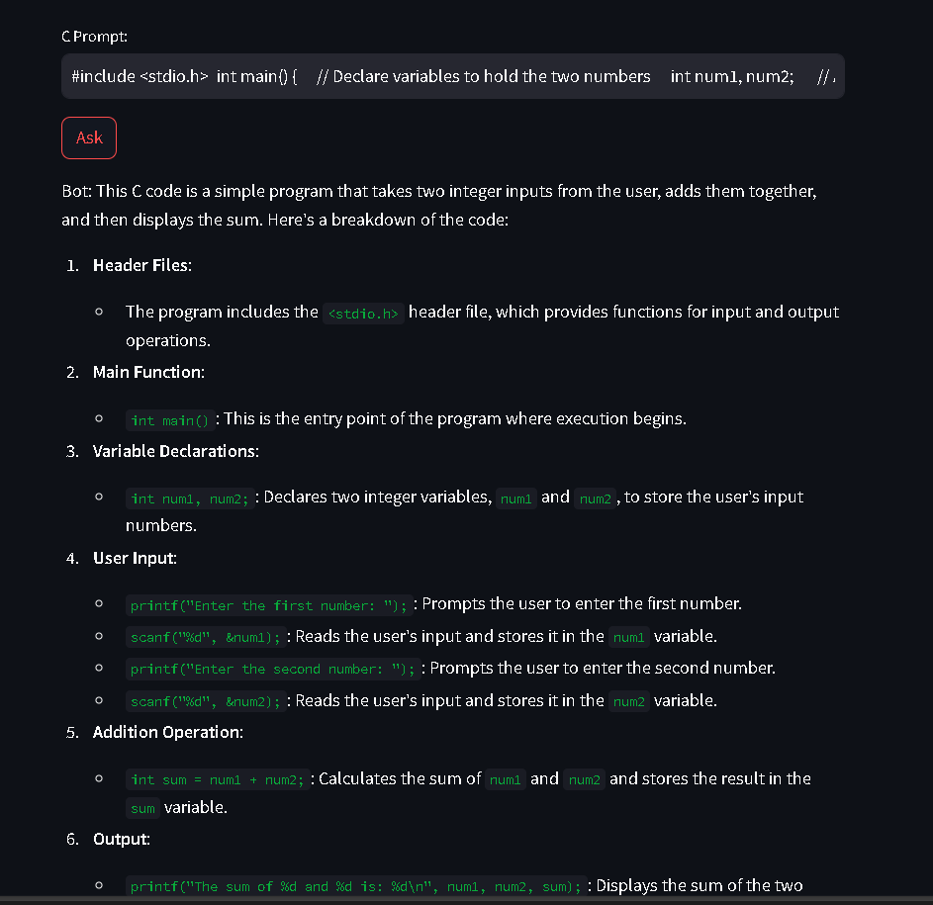
User Interface
C

Slide 6
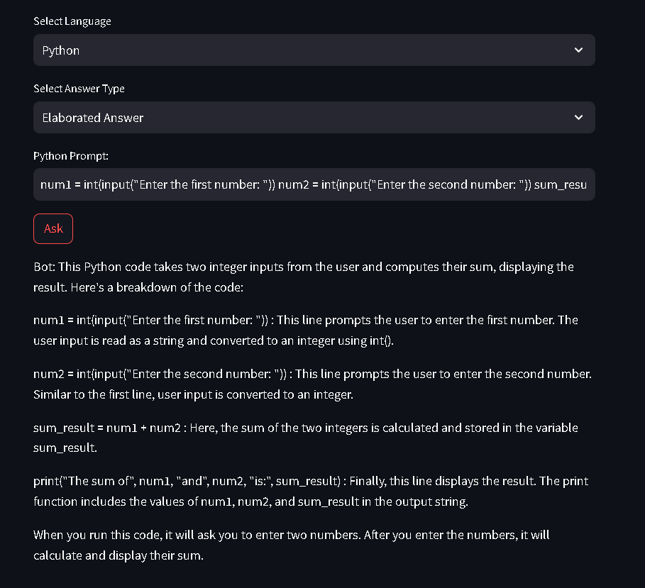
User Interface
Python

Slide 7
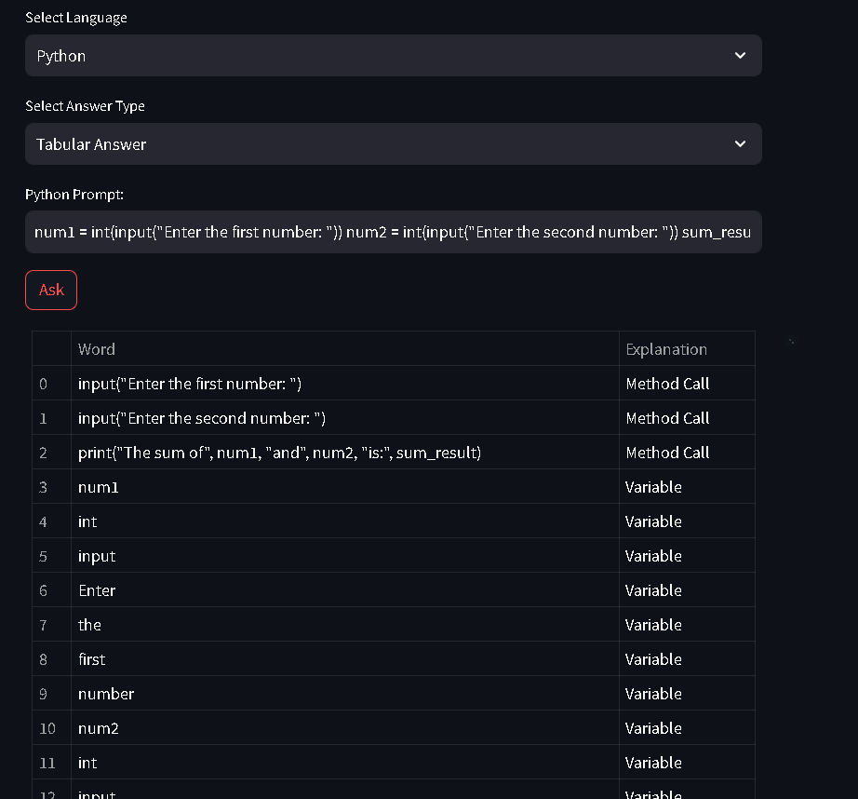
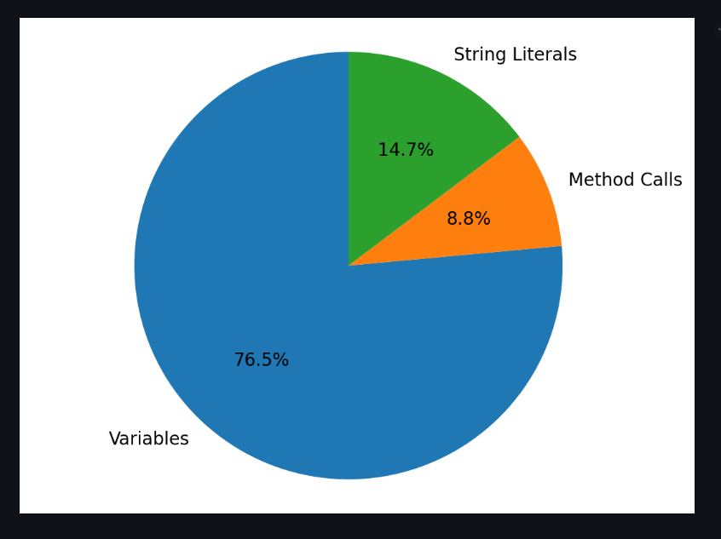
Tabular Responses
Python

Slide 8
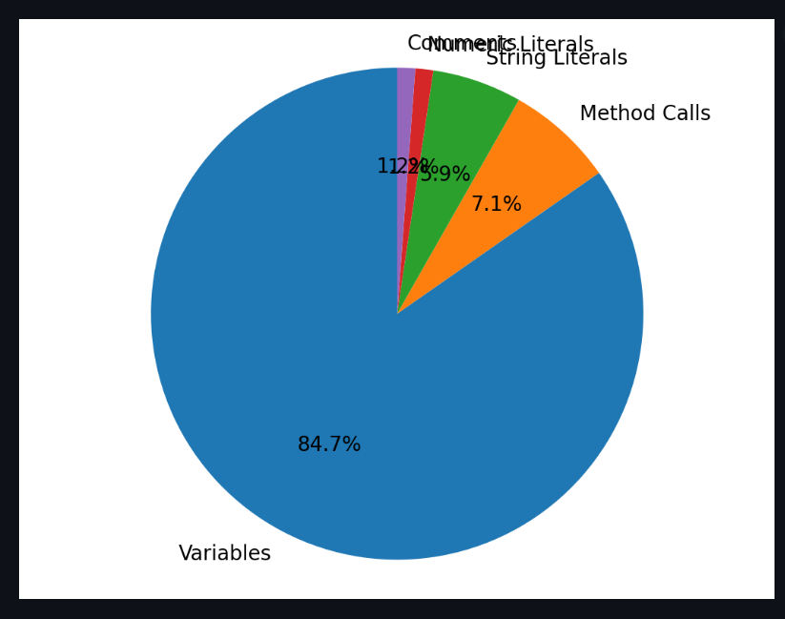
Tabular Responses
C

Slide 9
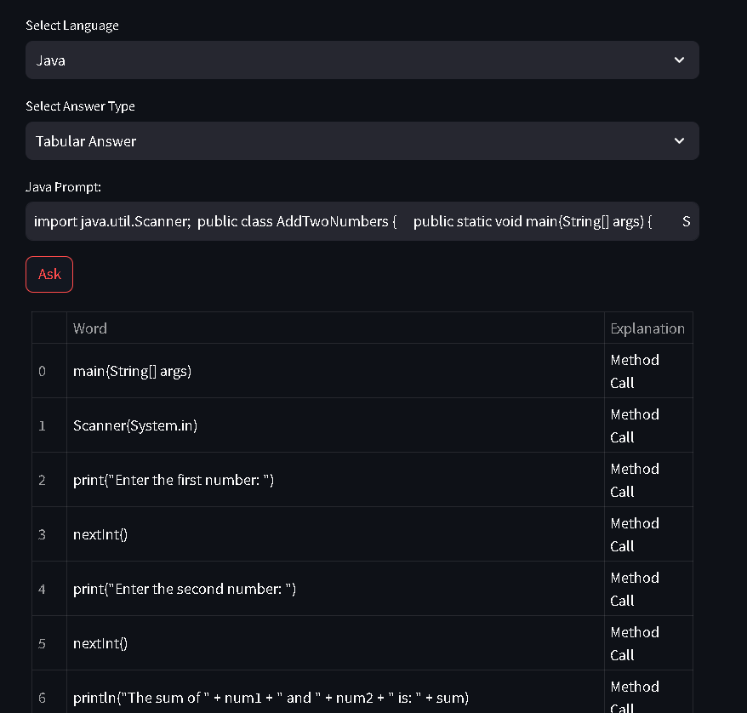
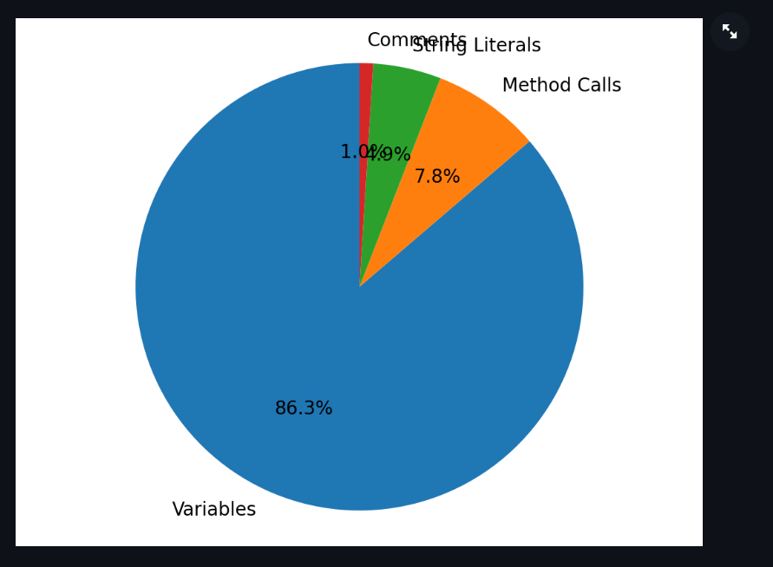
Tabular Responses
Java

Slide 10
Technologies Used
Python: Backend language for application logic, integration with AI model, and syntax checking functionality.
Streamlit: Frontend framework for building the web-based interface, providing an interactive user experience.
Generative AI API:Integration with Generative AI service for conversational capabilities, enabling natural language interactions

Slide 11
Conclusion
The Generative AI Chat Application fosters meaningful AI interactions,Enhancing productivity and learning. With features like syntax checking and generative chat, it’s a valuable tool for developers, learners, and AI enthusiasts. Future enhancements promise and even richer user experience

